Slide 1
Level 4/5 Group 5
Joseph Barber, Bethany Cowle,
Courtney-Jade Pearson, Henry Smith

Slide 2

Emotion 2: Onism
The frustration of being stuck in just one body that inhabits only one place at a time.
Why?
Many different paths and options.
Applies to the mechanics and gameplay.
HS

Slide 3
Narrative
Build narrative as you play.
Collecting memories.
Character feels emotions along with the player.
Monachopsis in narrative
HS

Slide 4
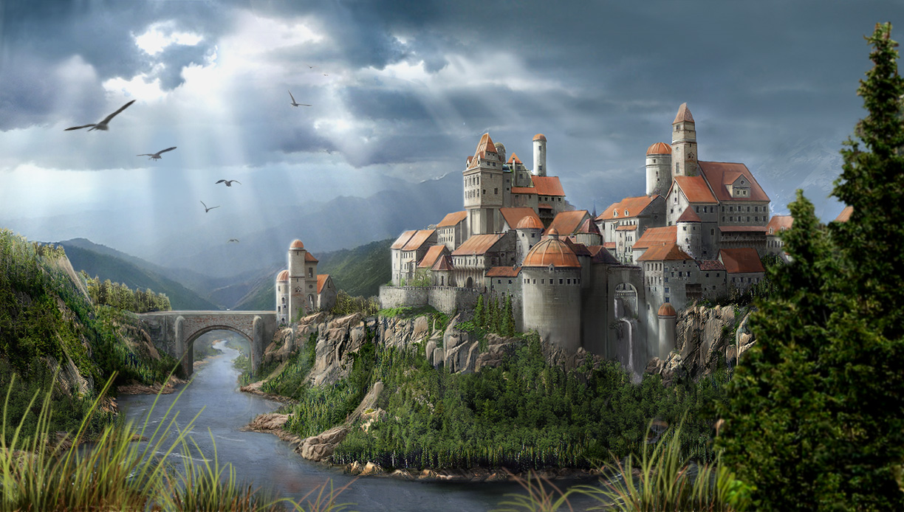
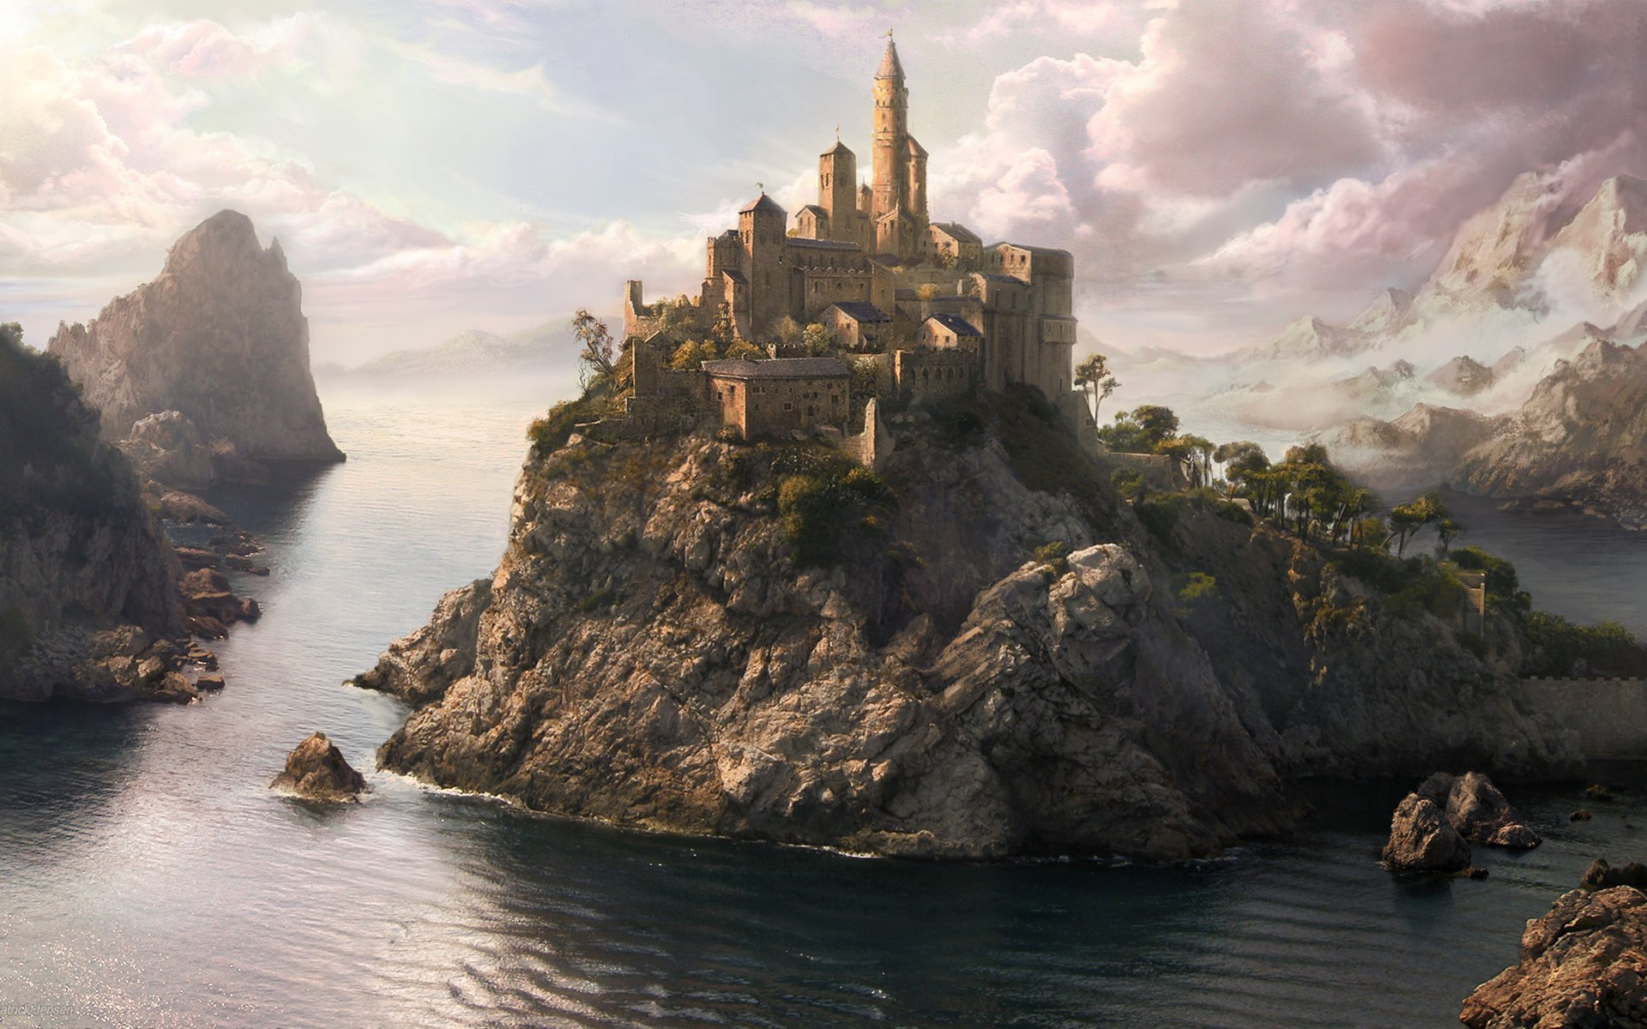
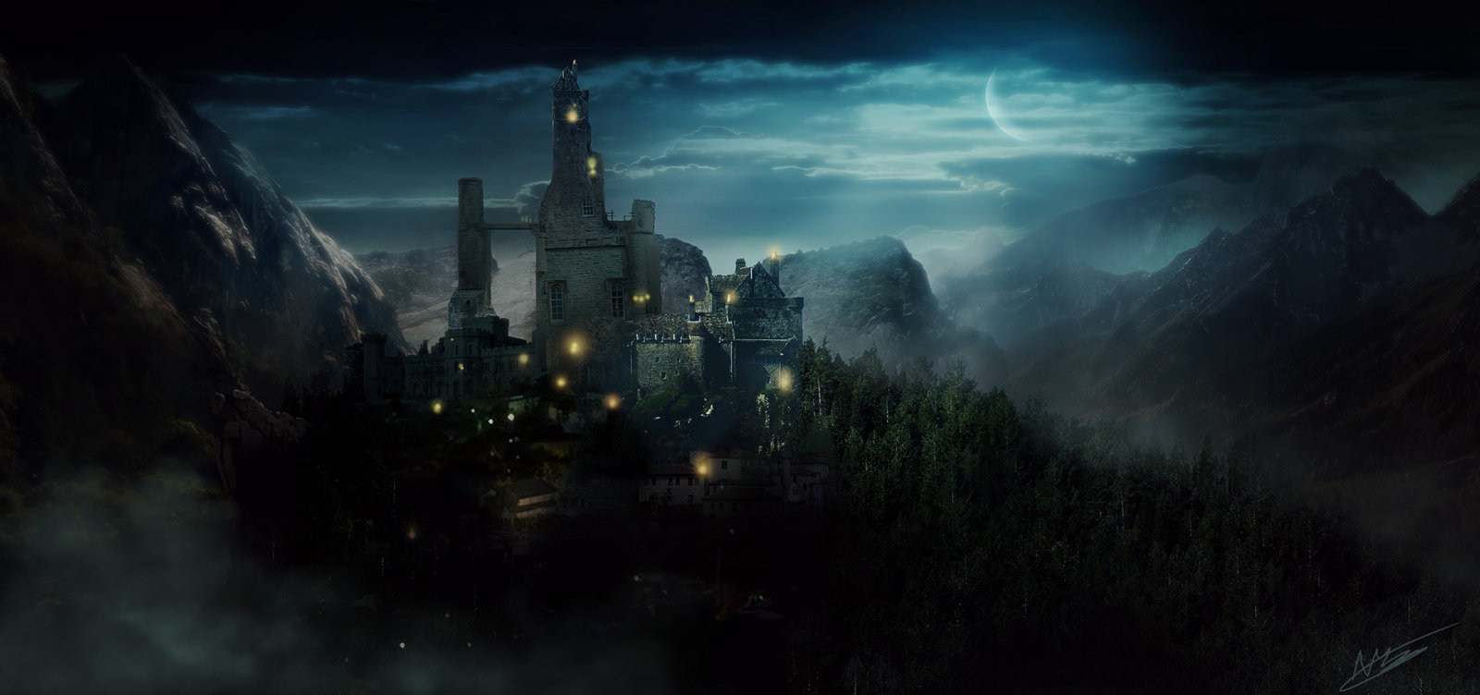
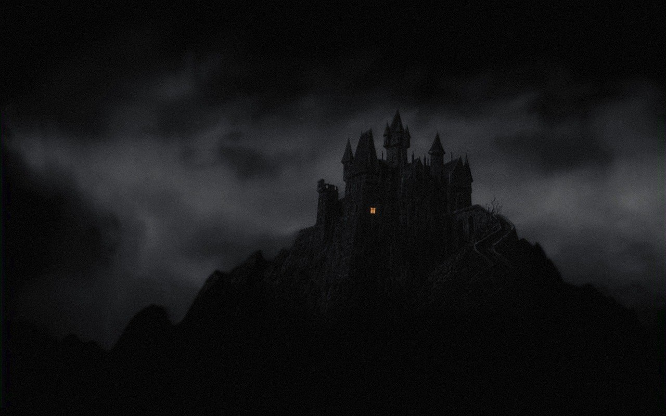
Mood boards
HS

Slide 5
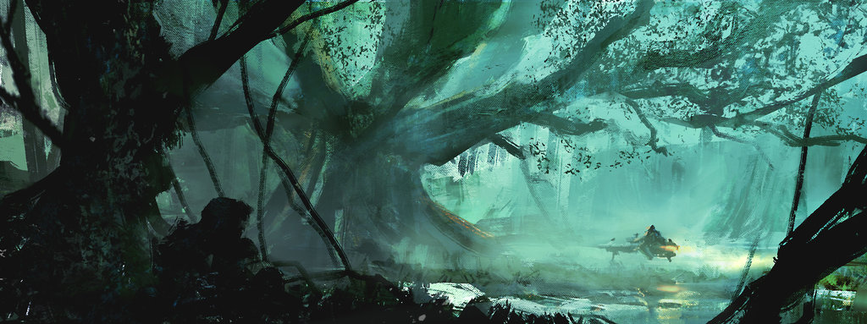
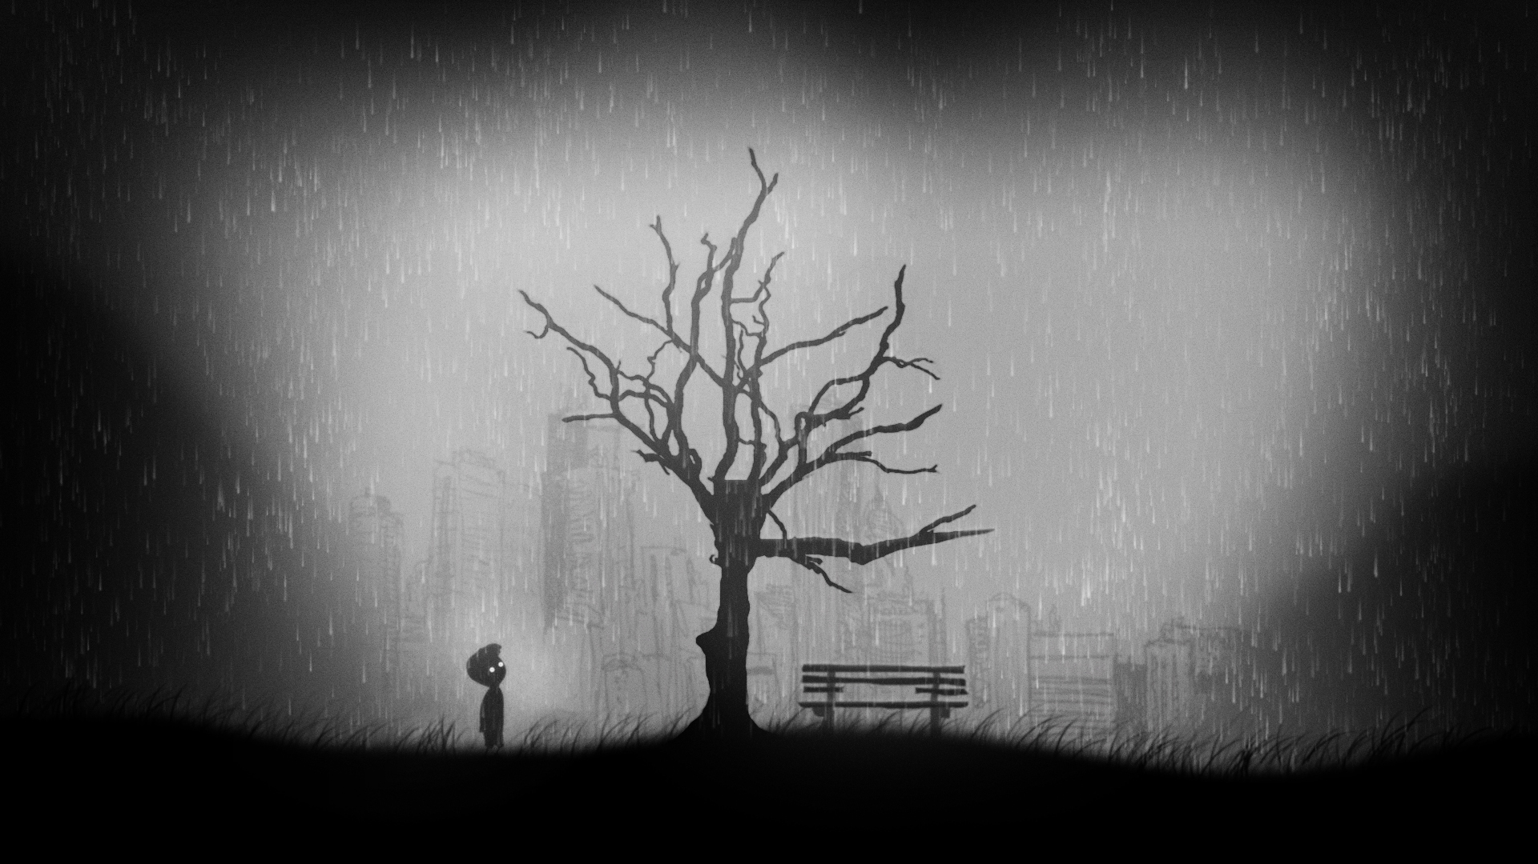
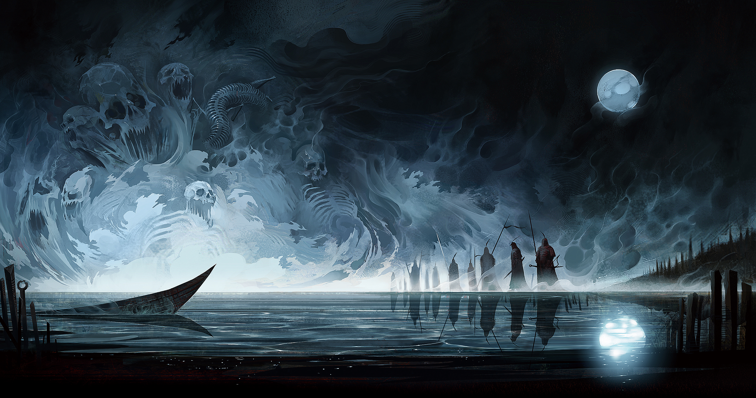
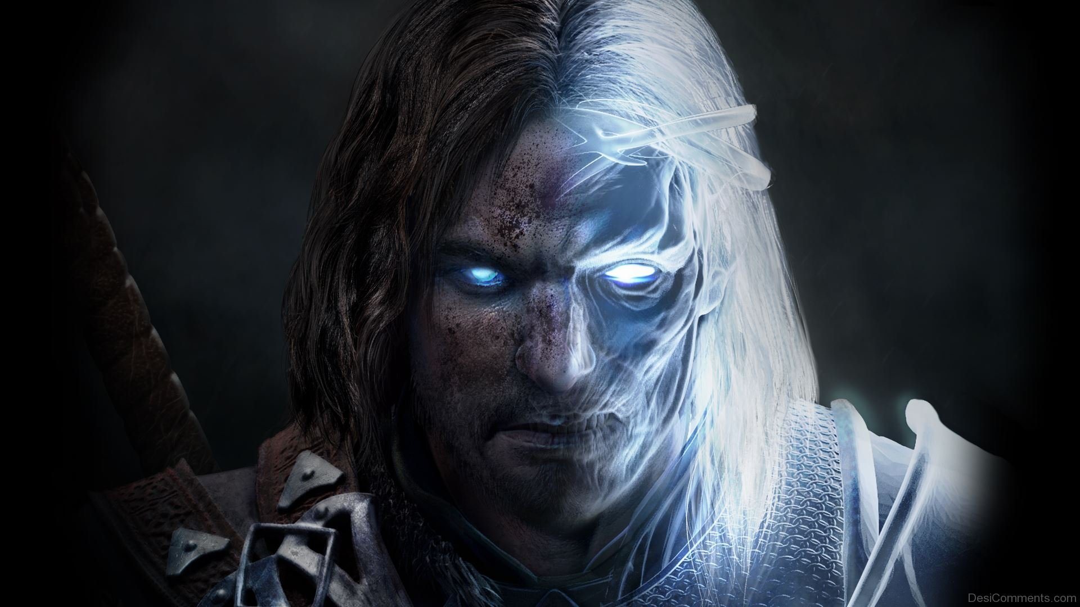
Mood boards
HS

Slide 6
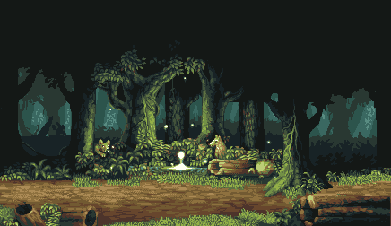
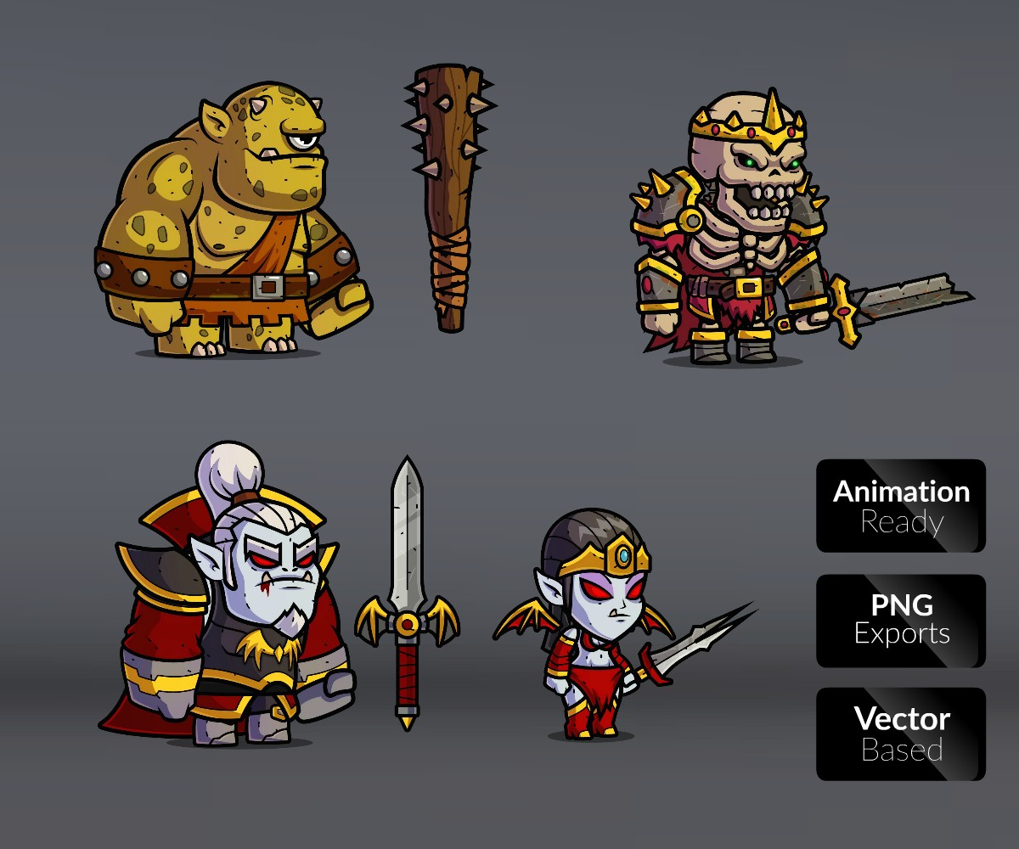
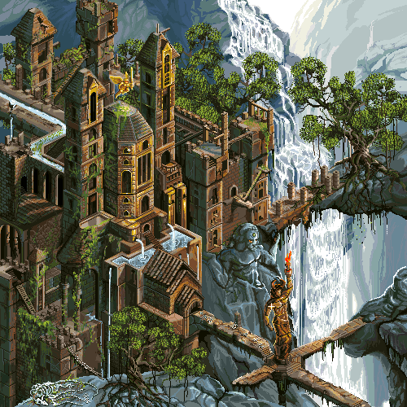
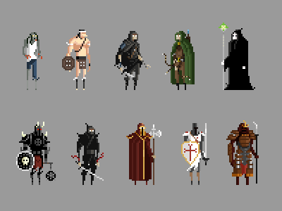
Art style
HS

